Slide 1
Get Ready….
Register a Scalar account: http://scalar.usc.edu/works
Github page for the workshop:
https://github.com/tech-at-arl/Digital-Scholarship-Institute/tree/master/Multimodal%20Online%20Publishing%20with%20Scalar (go to the Github site and click on “Multimodal Publishing…”)

Slide 2
Multimodal Publishing with Scalar
ARL Digital Scholarship Institute
June 5-9, 2017
Harriett Green, Head, Scholarly Communications and Publishing, University of Illinois
Dan Tracy, LIS and Research Services Librarian, University of Illinois

Slide 3
What is Multimodal Publishing?
What do we mean by multimodal publishing?
Digital publications that bring together text with images, video, other media…
…that provide different ways for readers to engage with or navigate the content.
”Multimedia scholarship, although it encompasses many forms, might best be understood as work that refuses the print-digital binary. It is by definition beyond print, even while text often remains a crucial element of such work. It typically includes the following elements: multiple media(text, sound, image, moving images), user interactivity, a networked or database structure, nonlinear components, and a heightened attention to aspects of design, aesthetics, or form.”
McPherson and Anderson

Slide 4
What Does Multi-Modal Publishing Entail?
For scholarship, it enables integration of multimedia evidence in ways not possible in print scholarship and also provides the audience with ways to engage that media.
Related terms: scholarly multimedia, web texts, hypertext
Comparative forms:
Exhibits (covered in Omeka session)
Digital / critical editions
HTML websites

Slide 5
History and Common Platforms
Vectors / Scalar
WordPress
Drupal / HTML
Fulcrum (FUTURE)
Vega (FUTURE)

Slide 6
Diversity of Possibilities….
eLife: https://elifesciences.org/articles/26775
Georgia Coast Atlas: http://georgiacoastatlas.org/
Practical Matters journal:http://practicalmattersjournal.org/2016/06/29/root-of-the-route/
Knotted Line: http://knottedline.com/
Hearing the Music of the Hemispheres: http://scalar.usc.edu/anvc/music-of-the-hemispheres/index

Slide 7
Activity 1: Site Analysis
In groups of 3-4, look at the two multimodal publications assigned to your group.
Go to the Github page for links to the digital publications!
Identify common features and structures, and issues that you think might be common concerns (in terms of process, information organization, social and legal concerns, technical requirements) with the two different sites.
Also identify some areas where the two sites diverge in these areas.

Slide 8
Discuss….
What did you notice in your site analysis?
What were key elements?
What did you learn?

Slide 9
Core Concerns for Multimodal Publishing: Copyright
Use of in-copyright media (which will include most video/audio media) can pose difficult fair use questions, but there are a number of “best practices” documents available that point to an emerging consensus.
Statement of the Fair Use of Images for Teaching, Research, and Study by the Visual Resources Association
Code of Best Practices in the Fair Use for Visual Arts
Key theme in best practice: use of in copyright works should not be “merely illustrative”; they should be important to the argument (have specific accompanying critical commentary of the specific media or otherwise be clearly necessary to the purpose). “Merely illustrative” = decorative, or easily interchangeable (do I need this specific picture of a dog, or would any dog do?).
Columbia Fair Use Checklist

Slide 10
Core Concerns for Multimodal Publishing: Discovery of Media Content
Where is it?
DPLA, digital repositories, born-digital material online, analog material that needs to be digitized… Any given project may need to draw from multiple sources.
What is the quality of the available digital versions?
The more scholarly and final the expected product (vs. say classroom examples that are not made public), the more likely you need high quality digital versions.

Slide 11
Core Concerns for Multimodal Publishing: Metadata, Data Curation, File Management
What is the quality of the metadata of the digital media you have? Does it need remediation or enhancement?
How are you tracking your metadata and what level of metadata description do you need in the publication itself?
How are you storing your files? Are you following file name conventions?
Use of spaces and special characters in file names can cause buggy behavior in many digital systems, including Scalar!

Slide 12
Core Concerns for Multimodal Publishing: Writing Process
Integrating text and multimedia requires different writing strategies than a normal essay.
Must think through issues of relationship of text and media.
Must think about hypertext navigation of content and not just linear reading of the text when designing organization.
A scholarly publishing platform is not a drafting tool.
A scholarly publishing platform is not a drafting tool.
A scholarly publishing platform is not a drafting tool.
A scholarly publishing platform is not a drafting tool.
A scholarly publishing platform is not a drafting tool.
A scholarly publishing platform is not a drafting tool.

Slide 13
Core Concerns for Multimodal Publishing: Varying Degrees of Technical Difficulty
Cloud / web-hosted platform?
ISSUES: relatively low overhead; technical difficulties dependent mainly on usability of author interface.
Self-hosted open source platform?
ISSUES: Need web server space; technical support to install the software out of the box
Do you need modifications to an open source platform?
ISSUES: Need to hire a programmer to install and/or build plug ins
Do you need a hand-coded site?
ISSUES: Hire programmer and web designer to build the website

Slide 14
Core Concerns for Multimodal Publishing: Sustainability
Who is responsible for updating/maintaining content?
Static publication vs. publication involving content modifications or additions over time
Minimal even for static publications: ensuring links continue to function, media works
Who is responsible for storing the content?
How long should it be available? Who will preserve it? Can it be preserved—or rather in what ways can it be preserved and in what ways can it not?

Slide 15
Prelim Discussion: Structure of a Scalar site
Media / Text
Pages
Paths
Book
Scalar: How would you link media objects + pages into paths?

Slide 16
Activity 2: Map Out a Multimodal Site for Scalar
Browse through and select sample text and media content provided to plan out a site on a topic.
Go to Github page for links to sources
In a group, map out the structure of the site on the large tablet.
Use smaller sticky notes to represent different types of content—different colors for different types of content (media, annotation, main body text).
Represent distinct pages.
Represent connections between pages with arrows or indicators.

Slide 17
ACTIVITY 2: Potential Sources for Data
Diversity in the Desert: https://www.lib.umich.edu/diversity-desert/welcome.html
Radical Responses to the Great Depression: https://www.lib.umich.edu/radical-responses-great-depression/
Enchanting Ruins: https://www.lib.umich.edu/enchanting-ruin-tintern-abbey-romantic-tourism-wales/
Illinois Digital Collections: https://digital.library.illinois.edu/collections/810eac30-e3fb-012f-c5b6-0019b9e633c5-e

Slide 18
Activity 2: Map Out a Multimodal Site for Scalar
Browse through and select sample text and media content provided to plan out a site on a topic.
Go to Github page for links to sources
In a group, map out the structure of the site on the large tablet.
Use smaller sticky notes to represent different types of content—different colors for different types of content (media, annotation, main body text).
Represent distinct pages – draw a block around the sticky notes that are on the same page.
Represent connections between pages – draw arrows or use other indicators.

Slide 19
Discuss….
What do you think about the possibilities and challenges of multi-modal publishing generally thus far?
Any questions about the process and tools for multi-modal publishing?
Other thoughts?

Slide 20

Scalar Account Set Up
Start your Scalar account at: http://scalar.usc.edu/works
Click “Register”
Confirm in your email
Go back and log in

Slide 21

Break!
Please make sure your Scalar account is set up and activated before we return.

Slide 22
Introduction to Scalar
ARL Digital Scholarship Institute
June 5-9, 2017
Building a Multi-Modal Publishing Project

Slide 23
Scalar: An Introduction
http://scalar.usc.edu/works
EXAMPLE SITES:
http://freedoms-ring.org/
http://scalar.usc.edu/anvc/the-art-bulletin/index
http://scalar.usc.edu/works/growing-apart-a-political-history-of-american-inequality/index

Slide 24
Strengths of Scalar
Multimedia integration with text.
Annotation of media.
Creating “paths” through content for readers, supplemented by other ways of interlinking content like tags.
Relatively easy to do these things “Out of the Box” without hiring a graphic designer, web developer, programmer, etc.—though if you could use those people to make something more elaborate.
Visualizations and embedded widgets.
Flexibility.

Slide 25
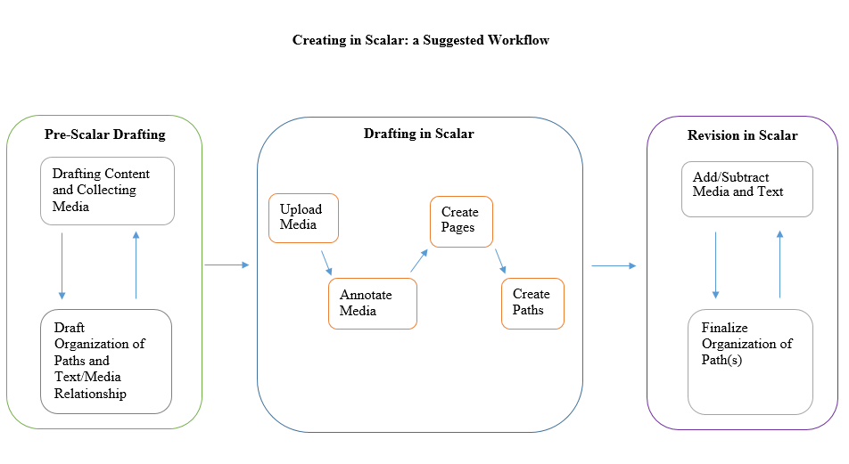
Productive workflow in Scalar?
By Dan Tracy
Notes:
This is why we did the initial drafting in the first half, and now we’re working in Scalar.

Slide 26
Potential Sources for Data for Your Site
Diversity in the Desert: https://www.lib.umich.edu/diversity-desert/welcome.html
Radical Responses to the Great Depression: https://www.lib.umich.edu/radical-responses-great-depression/
Enchanting Ruins: https://www.lib.umich.edu/enchanting-ruin-tintern-abbey-romantic-tourism-wales/
Illinois Digital Collections: https://digital.library.illinois.edu/collections/810eac30-e3fb-012f-c5b6-0019b9e633c5-e

Slide 27
Start Your Scalar Site: Dashboard
Notes:
Create your book by starting in the Scalar Dashboard:
Open book
Show user sharing
How to edit metadata for book

Slide 28
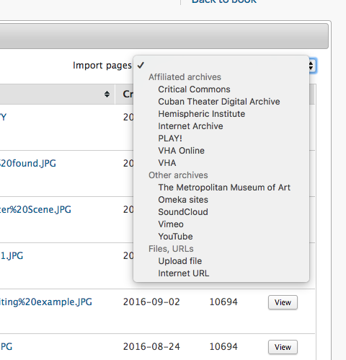
Media Options

Slide 29
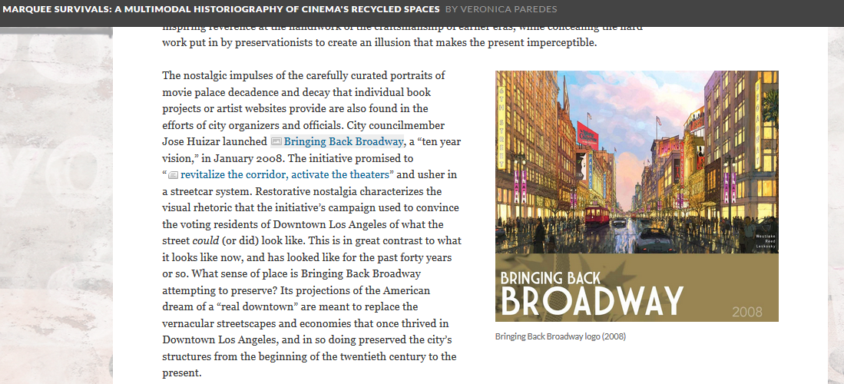
Ways to Use Media In Scalar: Commentary/Critique

Slide 30
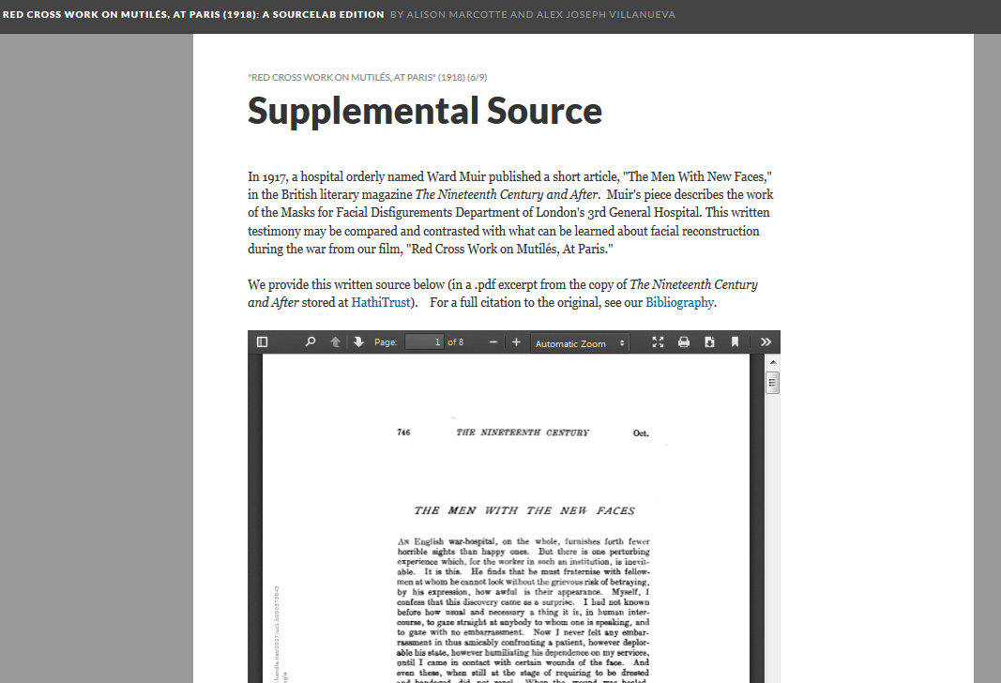
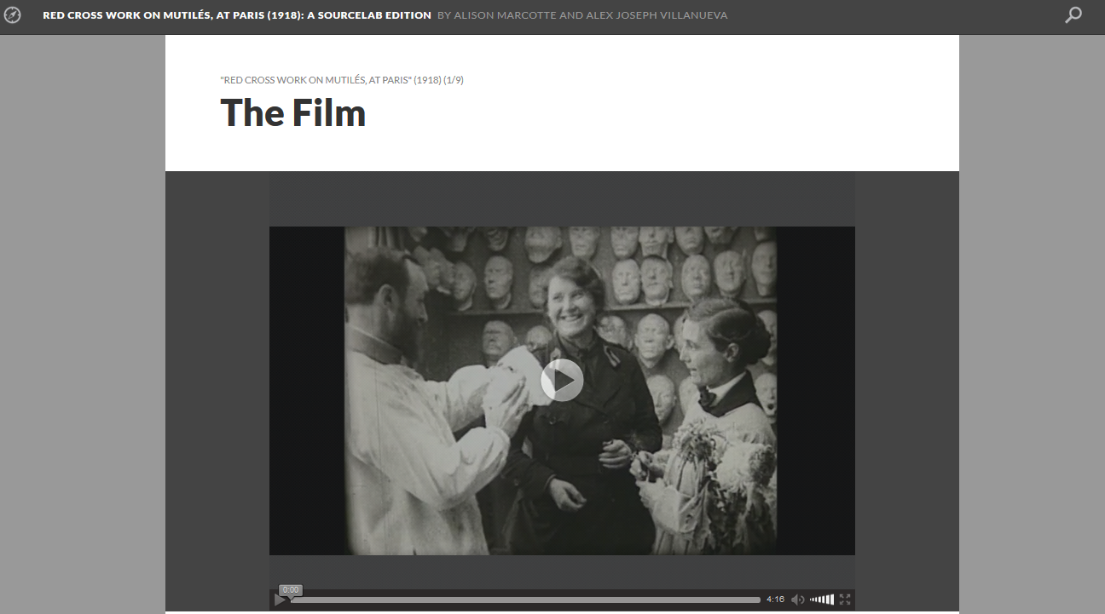
Ways to Use Media In Scalar: Original Text

Slide 31
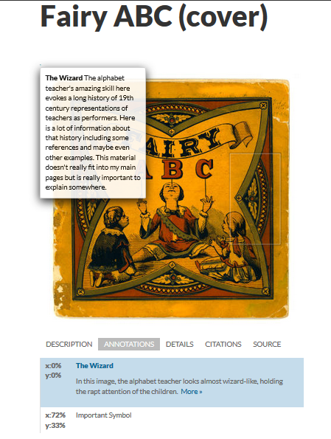
Ways to Use Media In Scalar: Annotation
*“Scholarship” in this annotation totally made up for example purposes!

Slide 32
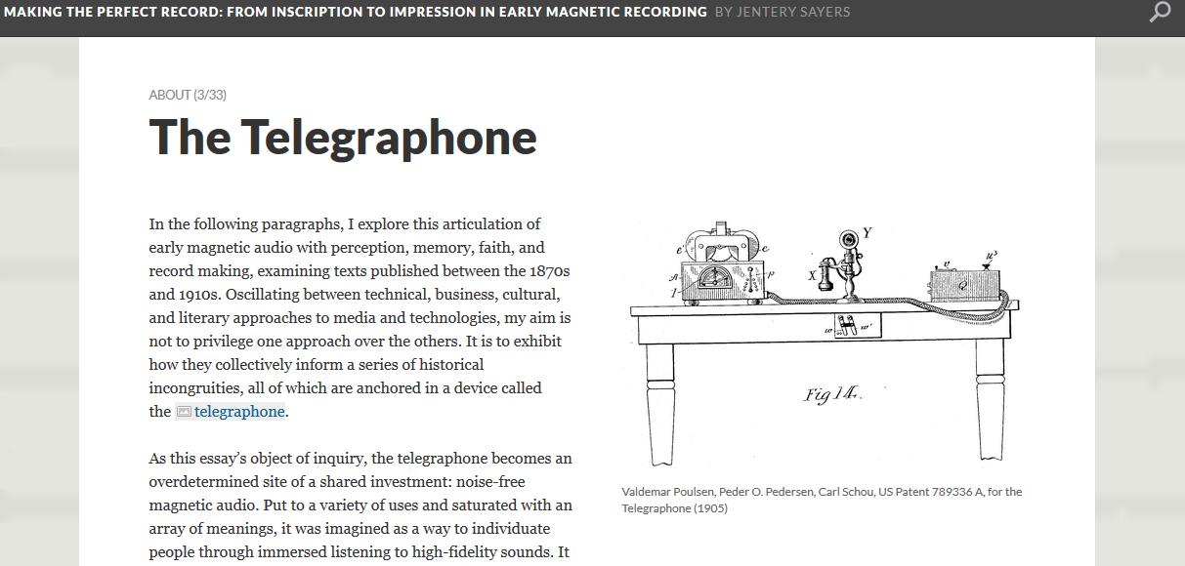
Ways to Use Media In Scalar: Illustration

Slide 33
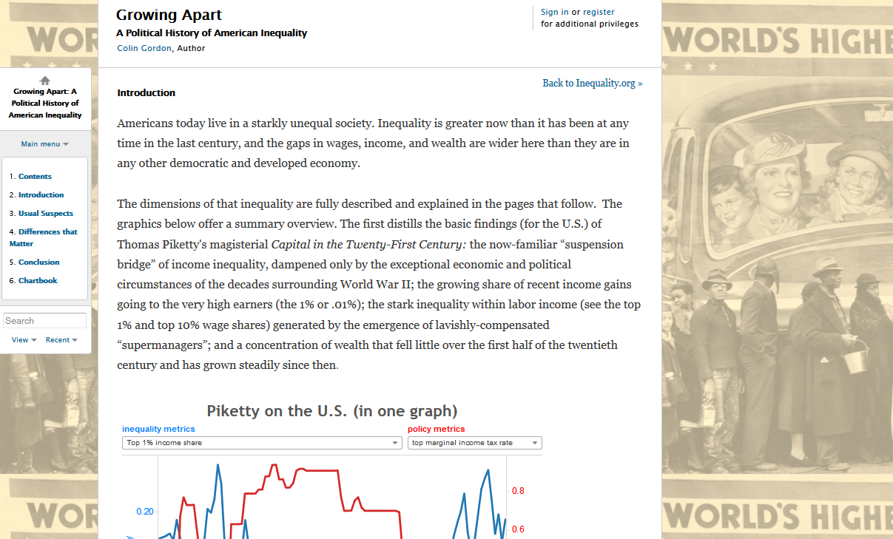
Ways to Use Media In Scalar: Background

Slide 34
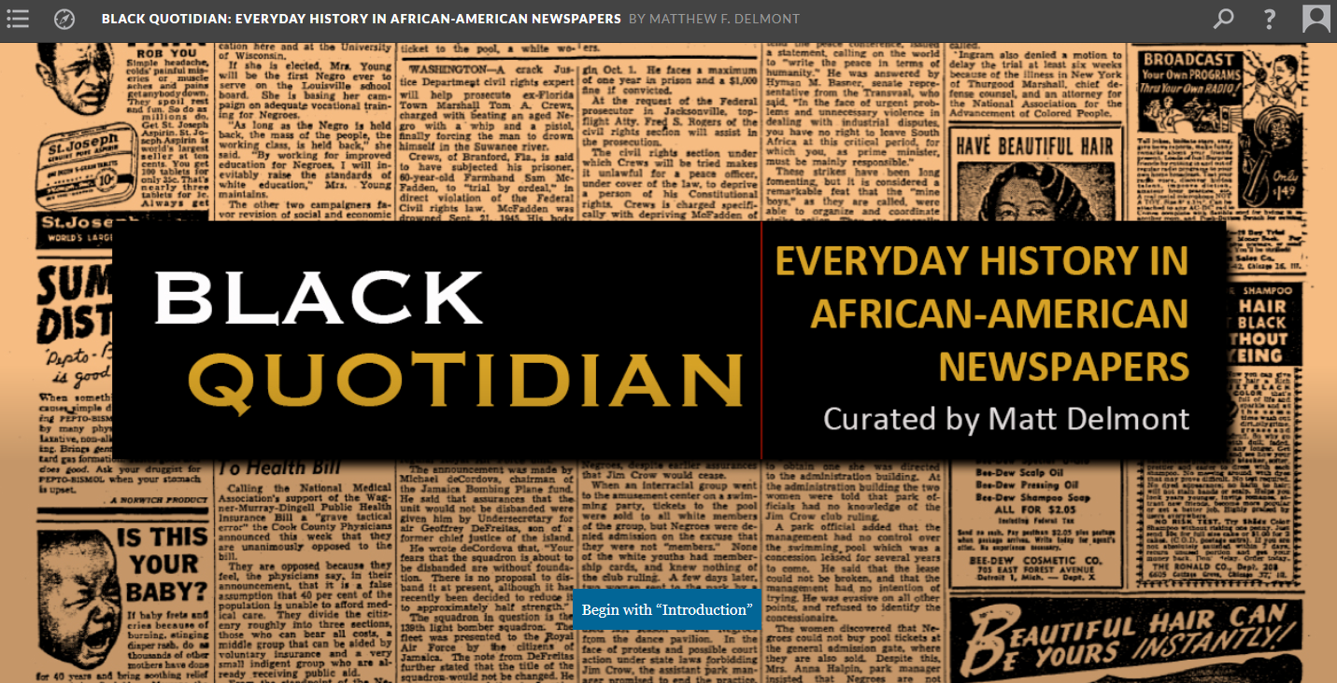
Ways to Use Media In Scalar: Title Page/Splash Page

Slide 35
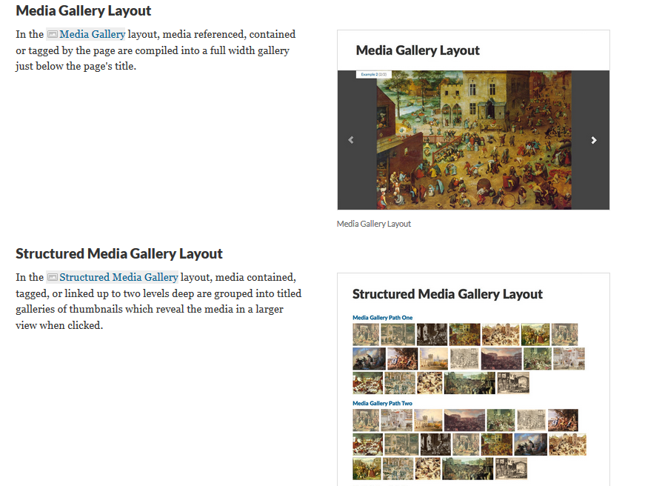
Ways to Use Media in Scalar: Media Galleries

Slide 36
REMEMBER: Multimedia & Copyright
Develop support for integration of multimedia in ways that meet fair use criteria, especially if the material is copyrighted and you have a fair use case.
Rights issues review
Public Domain
Licensed for re-use (Creative Commons or otherwise)
Fair use of copyright-protected works

Slide 37
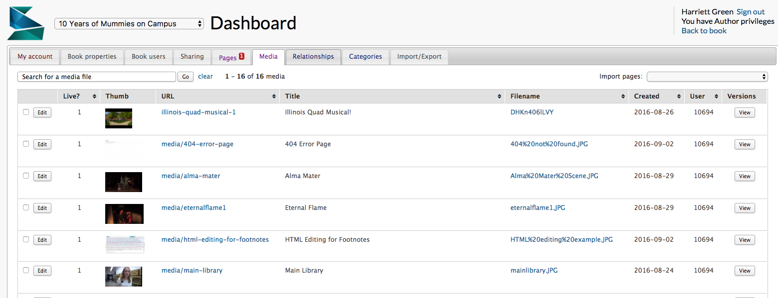
YOUR TURN: Upload media

Slide 38
Annotating Images
Click on Media tab
Select the part of the image you want to annotate
Enter annotations

Slide 39
Annotating video
Click on Media tab
Click on the link to the media you want to Annotate
Click on the Edit Annotations button
Click on the plus sign underneath the box to add annotations Select the time markers for the beginning and end of annotation

Slide 40
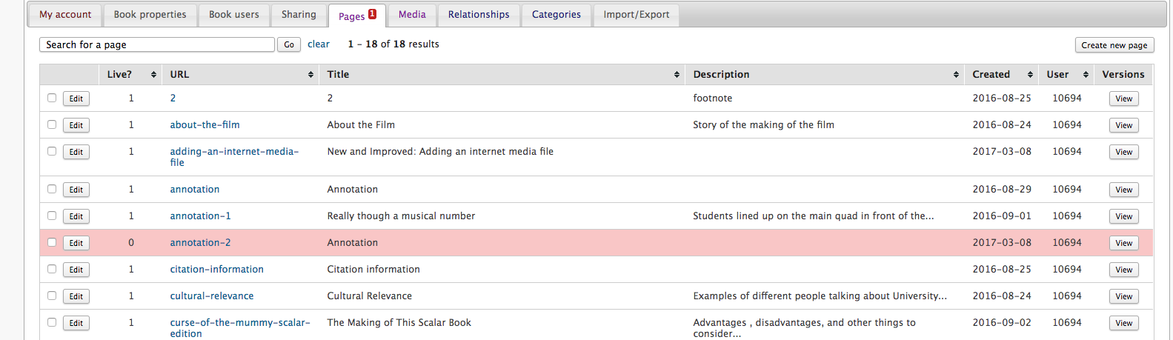
Create a Page
Notes:
Have them create a page

Slide 41
Structure of a Scalar site
Media
Pages
Paths
Book
http://scalar.usc.edu/works/performingarchive/index
Notes:
Show an example: http://scalar.usc.edu/works/performingarchive/index

Slide 42
Create a Path
Select page or media object
Go to bottom of edit screen, select it as the start of a path
Add items and pages – create your pages in ADVANCE!
http://scalar.usc.edu/works/fab-lab-histories-1/index

Slide 43
Site Planning
What are the primary goals of my website?
Who are the primary and secondary audiences?
What sections will the site include?
What will I do with the items on this website?

Slide 44
Building a Scalar Site
Create Pages
Go to Dashboard
Click on Pages tab
Click on Create a Page
Create/Designate a Home Page
Create 1 or more Paths
Create Table of Contents

Slide 45
Open Lab Time in Scalar
Scalar User Guide:
http://guides.library.Illinois.edu/scalar
Refer to mapped site work from Activity 2
Upload sample text and images from selected digital exhibition to your Scalar site
Create multiple pages
Create at least 1 path
What challenges do you encounter?

Slide 46
Build Your Scalar Site: Key Steps
Create Book and Home Page (“Index”)
Create Your Book on the My Book tab
Click on the Menu “Home” icon to get to your Home Page (‘/index’)
Build Pages
Click on Pages tab → Click on Create a Page
At the bottom of any page, click on New button
7 different layouts that feature media, embedded maps, and text + media
Create a Path
Structure of Scalar book – like a ‘slide show’
Go into edit view of a page
Choose “Make this page into a path”
Can add pages, media objects, and annotations

Slide 47





Advanced Scalar Use: Paths and Flexibility
Behind that path, though, you created a lot of other pages that you may not have put into the path but that readers might find their way to.
Each media item has a stand-alone page.
Each annotation has a page that pairs it with its media.
Any footnote (“Scalar note”) you created has its own page too.
.jpg

Slide 48
Advanced Scalar Use: Paths and Flexibility
Behind any path, you created many other pages that you may not have put into the path, but which readers might find.
Each media item has a stand-alone page.
Each annotation has a page that pairs it with its media.
Any footnote (“Scalar note”) you created has its own page too.
.jpg
Notes:
DAN: Pause halfway through open lab time to discuss paths….

Slide 49

Advanced Scalar Use: Paths and Flexibility
This is part of Scalar’s flexibility, and you can expand on this if you want:
You can annotate media with other media.
You can make media or annotation pages into pages in your path.
.jpg
.jpg
Notes:
DAN

Slide 50





Advanced Scalar Use: Paths and Flexibility
You also have the ability to create multiple paths.
These paths can converge, intersect, or be totally separate.
You just have to think about how users will get into these paths: from the starting page, from the Table of Contents, or some other route.
Pages can be in multiple paths, if you have a reason to do so, but a page can’t start multiple paths.
Page A
Page C
Table of Contents
Page A
Page B
.jpg
Page B
Notes:
DAN

Slide 51
Advanced Scalar Functions to Play With
Scalar Widgets
Video Annotations
Hypothes.is Annotations
Visualizations
Notes:
BOTH OF US

Slide 52
Discuss….
What were your challenges in building the Scalar site?
What are the strengths of Scalar?
What are the limitations?
What types of digital scholarship projects can you see using Scalar most effectively?
Notes:
BOTH OF US

Slide 53
Why Libraries and Digital Publishing?

Slide 54
Digital Publishing and Information Professionals
Libraries (primarily academic), archives, museums increasingly educating scholars on use of digital scholarship and publication tools, and often as creators of or partners on digital publications.
Cross-sector work in User Experience (UX).
LIS skills needed in DH publishing: UX, metadata, understanding copyright and access issues, digital preservation, understanding privacy and digital systems.

Slide 55
Why Would Your Users Want to Learn Multi-Modal Publishing?
Digital publishing increasingly a part of the lives of scholars.
Getting experience with a particular tool and collaborative processes common in digital scholarship work.
Tools impact the shape of the project with certain functionalities, and thus the experience of project members and the project’s end users (i.e., readers).
Other ideas?

Slide 56
How Do You Build Potential Services?
How do you see yourself using this in your work and/or with students and faculty?
What would you need to learn or acquire as resources in order to offer this as a library service?
What would be the challenges of offering library support or research service for multi-modal publishing?
Lingering questions about multi-modal publishing?

Slide 57
Questions?
Dan Tracy | dtracy@illinois.edu
Harriett Green | green19@illinois.edu

